Slide 1

Water level indicator
GROUP - 02
NAME | ID | PROGRAM
MABIN NOOR RASHID | 17-35941-3 | B.Sc in CSE
MUSHARUF HOSSAIN | 21-45112-2 | B.Sc in CSE
EFFAT ARA | 22-46090-1 | B.Sc in CSE
MD. ABU TOWSIF | 22-47019-1 | B.Sc in CSE
Electronic Devices Laboratory
Section - J
Spring 2022-23
Department of EEE
American International University-Bangladesh
WITH INSIGHT FROM RESPECTED
DR. A. A MOHAMMAD MONZUR-UL-AKHIR

Slide 2

Introduction
Motivation
Novelty/Difference with existing similar project
Methodology
Result and Discussion
Project Cost
Limitation
Conclusion
References
TOPICS

Slide 3
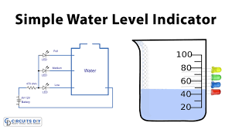
INTRODUCTION
Monitoring the water level
Prevent Overflow
Save Water
Water Pump
Electricity

Slide 4
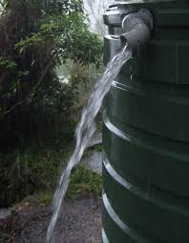
MOTIVATION
Precious Resource
Harmful for environment
Financial Loss
Wastage of Electricity

Slide 5
NOVELTY/DIFFERENCE WITH EXISTING SIMILAR PROJECTS
Existing Project
Complex Circuit
Expensive Components
Microcontrollers
Difficult for beginner
Our Project
Comparatively easy circuit
Inexpensive
Easy to Built

Slide 6

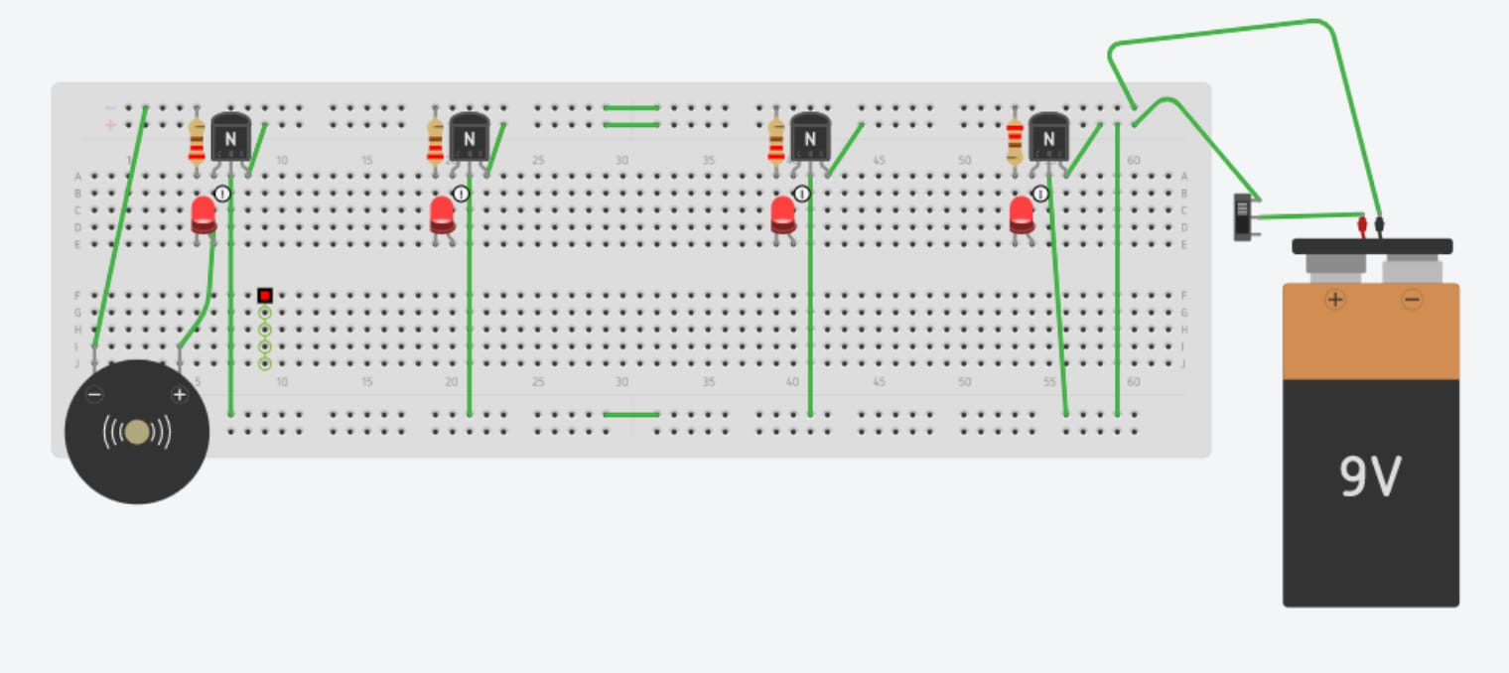
METHODOLOGY
Components used
Circuit connection
Test system
Figure 1 : Simulation

Slide 7
RESULT & DISCUSSION
Implementation
Test
Result
Indication

Slide 8
PROJECT COST
# | Items | Quantity | Amount
1 | Breadboard | 1 | 150
2 | 9V Battery | 1 | 80
3 | 9V Battery Connector | 1 | 10
4 | 220 Ω Resistor | 4 | 8
5 | Jumper Wire | 12 | 36
6 | Red LED | 4 | 8
7 | NPN Bi-polar Junction Transistor (BC547) | 4 | 20
8 | Buzzer | 1 | 40
9 | Electrical Wire (1 Gauge) | 1 | 20
10 | Switch | 1 | 10
 | Grand Total | - | 382 BDT

Slide 9
LIMITATION
Large Water Tank
Water Proof
Buzzer Singnal

Slide 10
CONCLUSION
Monitoring Water Level
Easy to construct
Cost Effective
Save Water
Prevent Overflow
Protect Water Pump

Slide 11
REFERENCES
[1] Liyan Gong, "BC547 Transistor Basic Knowledge, Pinout and Application", https://www.seeedstudio.com/blog/2020/09/10/bc547-transistor-basic-knowledge-pinout-and-application/
[2] Water level (device), https://youtu.be/Hiqi1MHJg6Y
[3] Robodoc, https://robodocbd.com/

Slide 12
THANK YOU

